Slide 1

Principles of Web Design 6th Edition
Form Submission

Slide 2
Using get or post
review
The difference between get and post is the way the data is sent to the server
method=“get”: this method sends the form information by including it in the URL
method=“post”: this method sends the form information securely to the server within the message body

Slide 3
Using the mailto Action
review
Lets you collect data from a form and send it to any e-mail address
<form action="mailto:joel@joelsklar.com"
method="post" enctype="text/plain">
In this case, the destination of submitted for will be the default mail app on the user’s device with email id joel@joelsklar.com as to.

Slide 4
Submitting form
In this example, we will create a form , and destination page.
Once the form is successfully submitted, the browser will redirect the user to the destination page.
The form should be validated first before submission.
Once the form is submitted, all elements in the form are going to be submitted to the destination page, the one in action attribute for <form> tag. action=“destination.html”

Slide 5
Destinatiom.html
<!DOCTYPE html>
<html>
<body>
you have been successfully transferred to this page
</body>
</html>
* For simplicity, create this file in the same folder where you save the next page form.html

Slide 6
Form.html
<!DOCTYPE html>
<html>
<body>
<p>Enter names in the fields, then click "Submit" to submit the form:</p>
<form id="frm1">
<button > Submit </button> <br>
First name: <input type="text" id="fname" name="fname"><br>
Last name: <input type="text" name="lname"><br>
</form>
</body>
</html>

Slide 7
Form.html
<!DOCTYPE html>
<html>
<body>
<p>Enter names in the fields, then click "Submit" to submit the form:</p>
<form id="frm1" method="get" action="destination.html">
<button > Submit </button> <br>
First name: <input type="text" id="fname" name="fname"><br>
Last name: <input type="text" name="lname"><br>
</form>
</body>
</html>
Click ok, then notice the URL bar!! It has lname and fname with their values, right?

Slide 8
Form.html
<!DOCTYPE html>
<html>
<body>
<p>Enter names in the fields, then click "Submit" to submit the form:</p>
<form id="frm1" method= "post" action="destination.html">
<button > Submit </button> <br>
First name: <input type="text" id="fname" name="fname"><br>
Last name: <input type="text" name="lname"><br>
</form>
</body>
</html>
Does the URL have lname and fname with their value? Of course not! post is More secure, and most often used method.

Slide 9
Form.html
<!DOCTYPE html>
<html>
<body>
<p>Enter names in the fields, then click "Submit" to submit the form:</p>
<form id="frm1" method= "post" action="destination.html">
<button > Submit </button> <br>
First name: <input type="text" required id="fname" name="fname"><br>
Last name: <input type="text" required name="lname"><br>
</form>
</body>
</html>

Slide 10
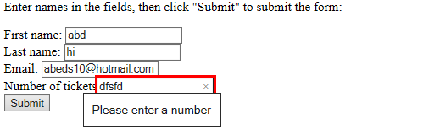
Form.html
<!DOCTYPE html>
<html>
<body>
<p>Enter names in the fields, then click "Submit" to submit the form:</p>
<form id="frm1" method= "post" action="destination.html">
<button > Submit </button> <br>
First name: <input type="text" required id="fname" name="fname"><br>
Last name: <input type="text" required name="lname"><br>
Email: <input type="email" required name="email"><br>
<input type="number" required id="numTickets" name="numTickets" >
</form>
</body>
</html>
Try to input character in the number field, then submit

Slide 11
Form.html
<!DOCTYPE html>
<html>
<body>
<p>Enter names in the fields, then click "Submit" to submit the form:</p>
<form id="frm1" method= "post" action="destination.html">
<button > Submit </button> <br>
First name: <input type="text" required id="fname" name="fname"><br>
Last name: <input type="text" required name="lname"><br>
Email: <input type="email" required name="email"><br>
<input type="number" required id="numTickets" name="numTickets" >
</form>
</body>
</html>
Try to input character in the number field, then submit

Slide 12
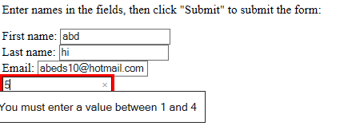
Form.html
<!DOCTYPE html>
<html>
<body>
<p>Enter names in the fields, then click "Submit" to submit the form:</p>
<form id="frm1" method= "post" action="destination.html">
<button > Submit </button> <br>
First name: <input type="text" required id="fname" name="fname"><br>
Last name: <input type="text" required name="lname"><br>
Email: <input type="email" required name="email"><br>
<input type="number" min="1" max="4" id="numTickets" name = "numTickets"> <br>
</form>
</body>
</html>

Slide 13
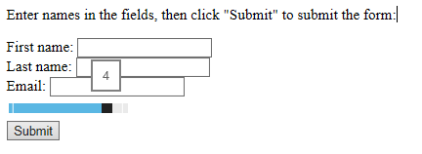
Form.html
<!DOCTYPE html>
<html>
<body>
<p>Enter names in the fields, then click "Submit" to submit the form:</p>
<form id="frm1" method= "post" action="destination.html">
<button > Submit </button> <br>
First name: <input type="text" required id="fname" name="fname"><br>
Last name: <input type="text" required name="lname"><br>
Email: <input type="email" required name="email"><br>
<input type= "range" min="1" max="4" id="numTickets" name = "numTickets"> <br>
</form>
</body>
</html>

Slide 14
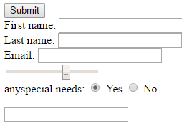
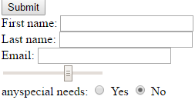
Form.html
<!DOCTYPE html>
<html>
<head>
<script src= "../js/modifydoc.js" > </script>
</head>
……
<input type= "range" min="1" max="4" id="numTickets" name = "numTickets"> <br>
anyspecial needs: <input type="radio" name="list" value="yes"onclick="enablenote(this)" checked>
<label for="Yes">Yes</label>
<input type="radio" name="list" value="no" onclick="enablenote(this)" checked>
<label for="No">No</label>
</form>
</body>
</html>
Full code : http://alkhate.myweb.cs.uwindsor.ca/60270/html/form.html

Slide 15
modifydoc.js
function enablenote(choice){
x = choice.value;
if (x=="yes")
{
document.getElementById("frm1").innerHTML = document.getElementById("frm1").innerHTML + '<textarea required name="note" id="note" rows="4" cols="50"> </textarea>';
}
else {
var elem = document.getElementById("note");
elem.parentElement.removeChild(elem);
}
}

Slide 16
References
W3school.com

